Slide 1
Quantum ensemble
Erinn and Andrew

Slide 2
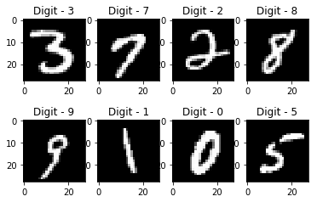
Classification problem in machine learning
Idea: Given N class-labelled training data, want to train a model function/classifier f to predict which class a test data belongs to.
Examples: Image classification

Slide 3
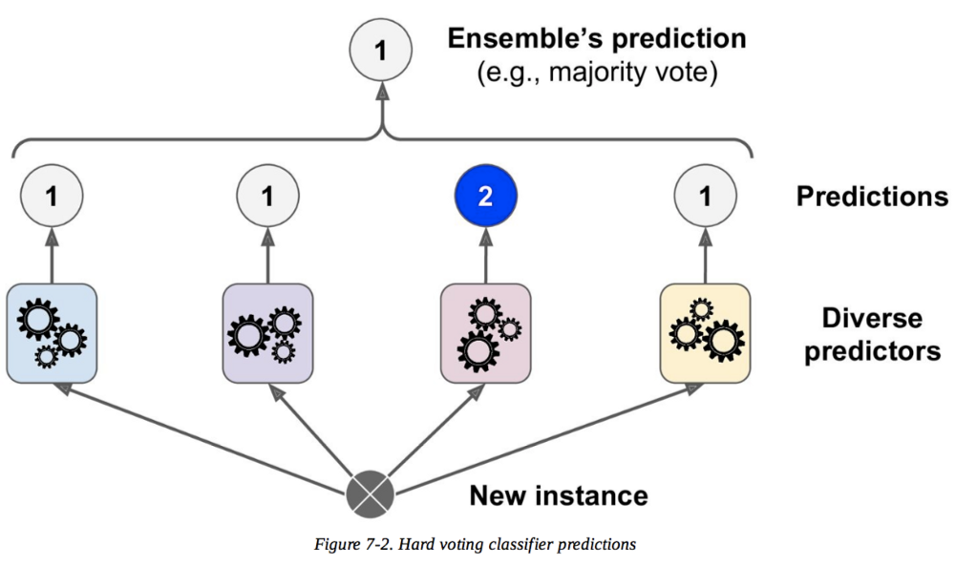
Ensemble methods for machine learning
Ensemble methods = Collection of classifiers

Slide 4
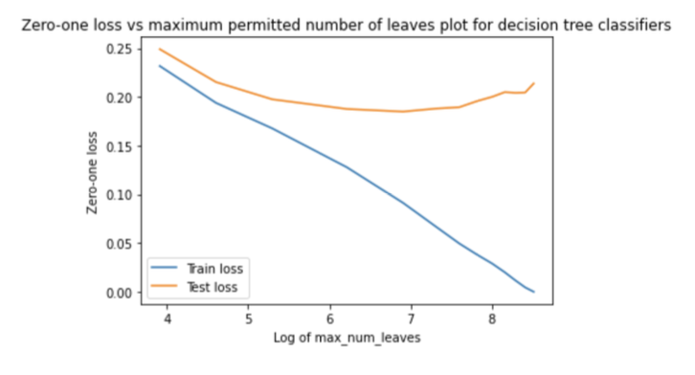
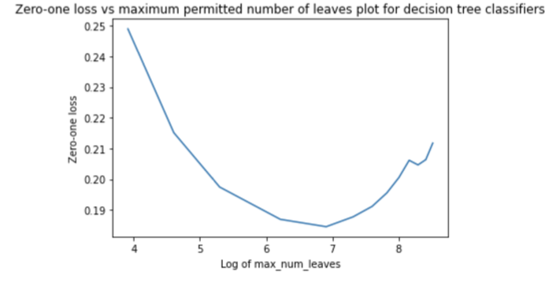
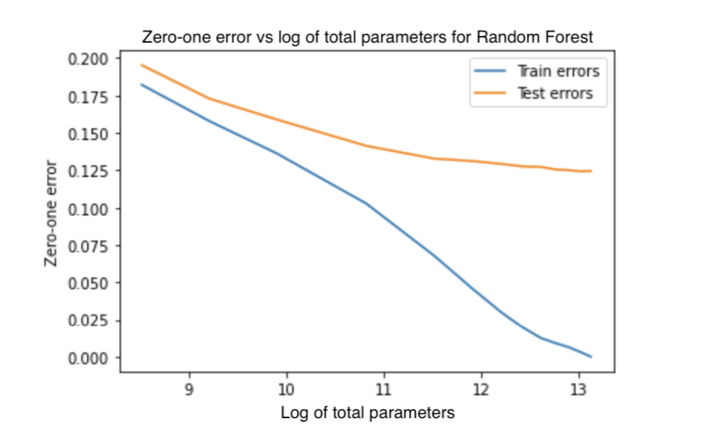
Why ensemble methods for machine learning?
Mean squared error = variance + bias
Variance ~ overfitting
Tackle the problem of overfitting - highly flexible models risk fitting to noise rather than capturing underlying structure.
Consider decision tree vs random forest:
Individual decision tree classifiers are prone to overfitting and require pruning. Random forest leverage statistical averaging to decrease variance of prediction while maintaining low bias.

Slide 5
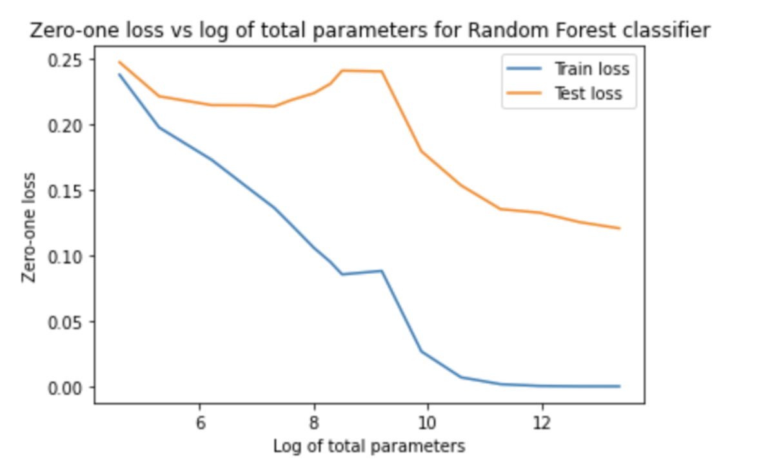
Classical double descent
Increase parameters of single decision tree until overfits, then multiply decision trees

Slide 6
Sufficient and necessary condition for ensemble to outperform individual classifiers
Sub-classifiers must be accurate (>50% accuracy) and diverse (decorrelated).

Slide 7
Why quantum ensemble?
Exponential speedup in constructing individual classifiers + performing predictions + aggregating results
speedup
speedup

Slide 8
Overview of the quantum ensemble algorithm
State preparation → Encodes feature vectors into qubits
Sampling in superposition → In d steps, generates 2^d different trajectories, with each trajectory potentially corresponding to a different model.
Learning via interference → Uses a classifier F (e.g. cosine similarity) and propagates similarity calculation simultaneously to all 2^d trajectories.
Measurement → Single execution of measurement collapses all trajectories into a final prediction (0 or 1).

Slide 9
Quantum ensemble circuitry

Slide 10
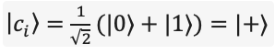
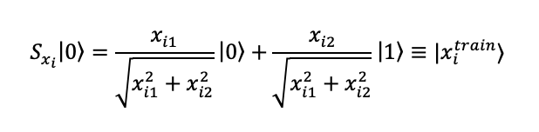
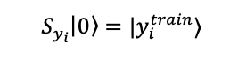
State preparation
Start with d control registers, 2*N data registers (N for training features + N for training labels).
Use Hadamard gates to transform every qubit in control register to uniform superposition of |0> and |1>.
Encode training set (x,y) into data register using some mapping S(x,y)|0> = |x,y>.
For now, we use the trivial encoding scheme for S(x,y):

Slide 11
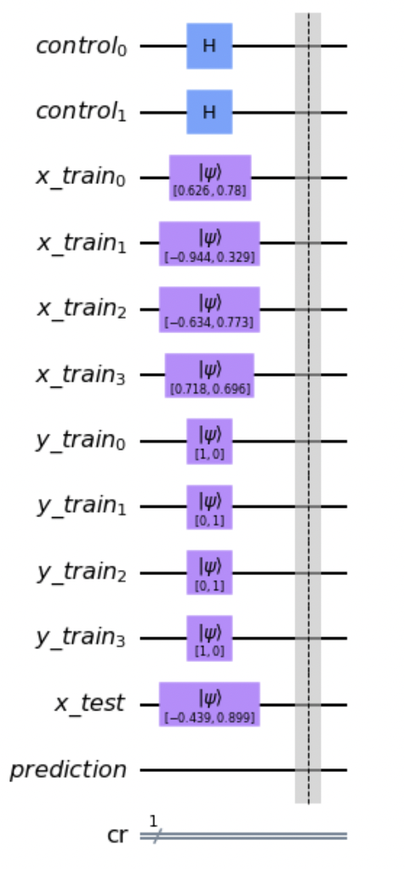
State preparation: Circuitry

Slide 12
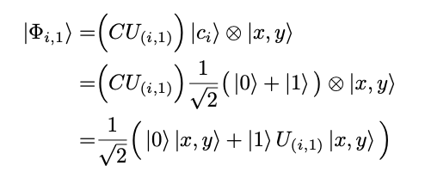
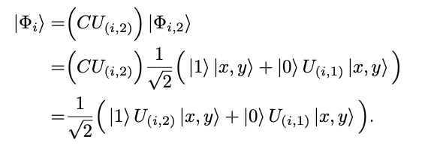
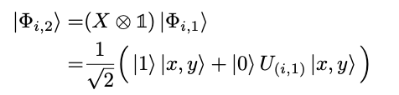
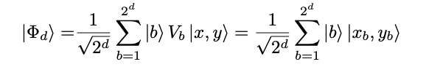
2. Sampling in superposition
Entangles the data path with each of the d control qubits (uniform superpositions of |0> and |1>), generating 2^d different feature transformations to the data path (mathematically, you get 2^d different terms in superposition after this stage), each corresponding to a different model.
In general, the unitary operators U(i,j) can be randomized and perform feature transformations to map input data into latent embeddings.

Slide 13
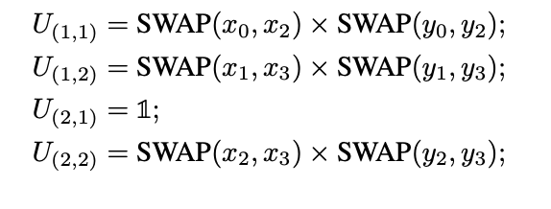
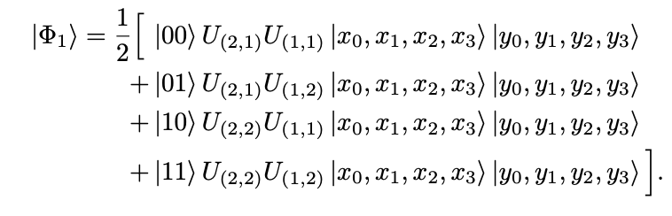
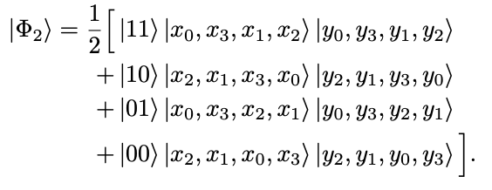
2. Sampling in superposition
An example sampling scheme for 4 training data. This ensures that each trajectory is independent from each other.
The quantum cosine classifier then selects a random entry of this superposition. For example, choosing the third entry yields x1, x3, x2, x0.

Slide 14
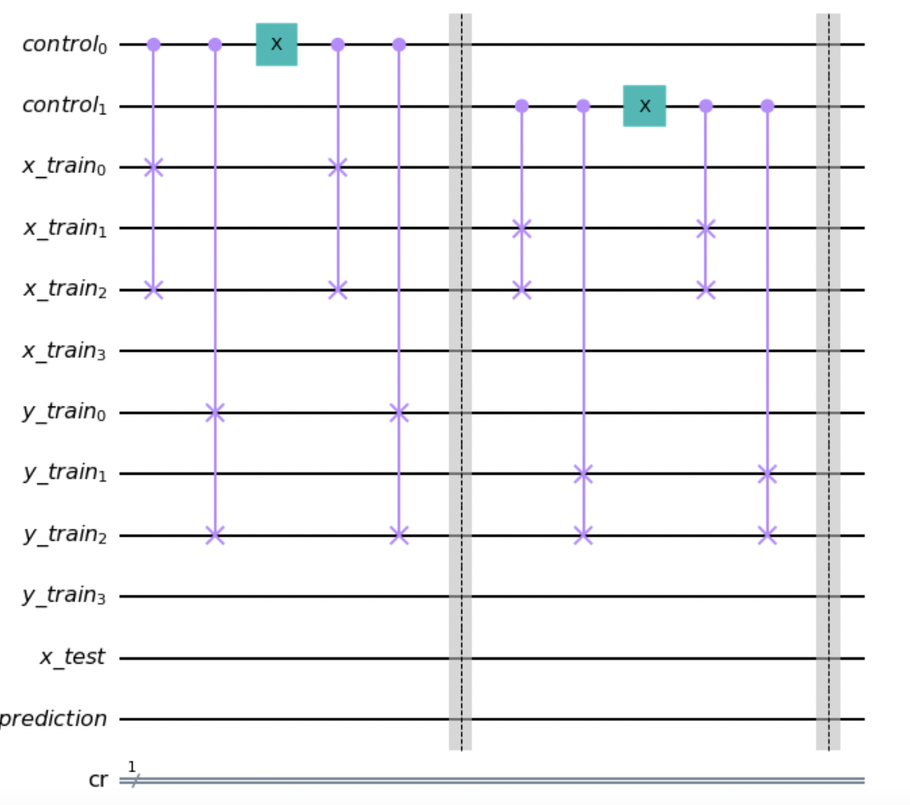
2. Sampling in superposition

Slide 15
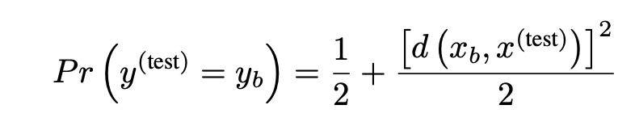
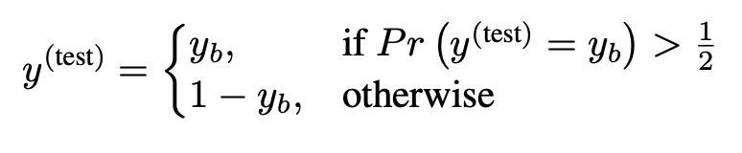
3. Quantum Cosine Classifier
Classical Cosine Classifier
Define d(x, y) = <x, y> / (||x||×||y||), i.e. the cosine distance between x and y.
Given a training data point, (x_{b}, y_{b}) and a testing data point, x^{(test)} , evaluate the probability of y^{(test)} = y_{b} :
The final classification rule:
Notes:
Notice that Pr(y_test = y_b) is bounded between [½, 1]. Thus, the classification only classifies y(test) = 1-y_b if x_b and x_test are orthogonal

Slide 16
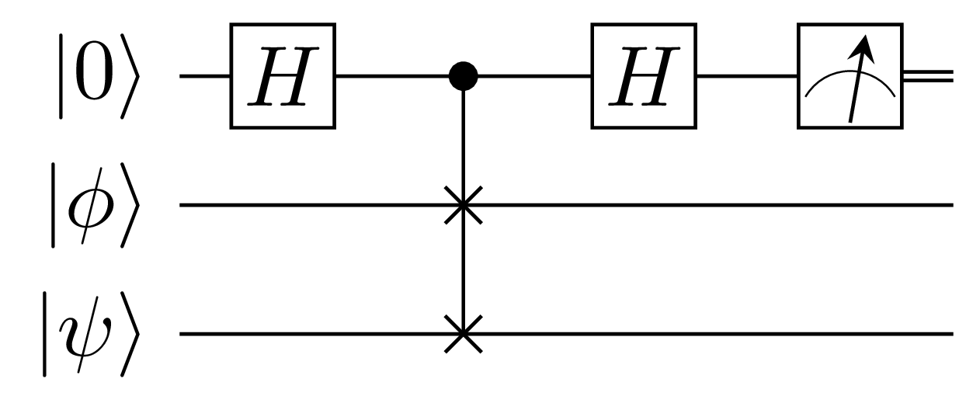
3. Quantum Cosine Classifier
Swap Test
Given two quantum states, |𝞥> and |𝞧>, the circuit outputs a Bernoulli random variable that is 0 with probability ½ + ½|<𝞥|𝞧>|²
Notes:
Notice that Pr(y_test = y_b) is bounded between [½, 1]. Thus, the classification only classifies y(test) = 1-y_b if x_b and x_test are orthogonal

Slide 17
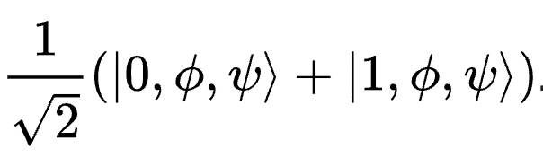
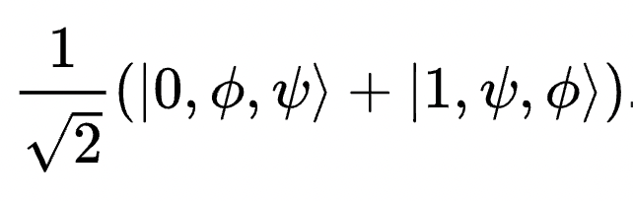
Swap Test Circuit
After the 1st Hadamard gate:
After the controlled swap gate:
3. After the 2nd Hadamard gate:
4. Measurement:
Notes:
Citation: https://en.wikipedia.org/wiki/Swap_test

Slide 18
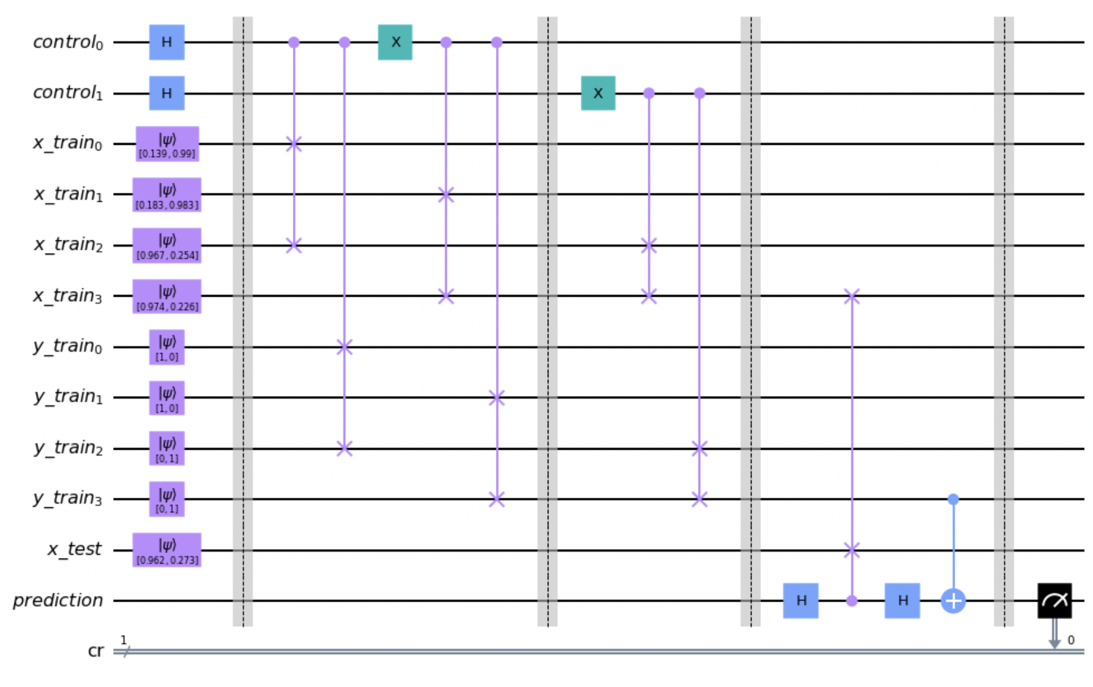
3. Quantum Cosine Classifier
Add the swap test to the quantum ensemble circuit
Perform a swap test between the last training sample and the testing sample
Notes:
Notice that Pr(y_test = y_b) is bounded between [½, 1]. Thus, the classification only classifies y(test) = 1-y_b if x_b and x_test are orthogonal

Slide 19
3. Quantum Cosine Classifier
Add the swap test to the quantum ensemble circuit
P(prediction = 0) = ½ + ½ |<x_train | x_test>|²
Cosine classifier output:
P(prediction = y_train) = ½ + ½ |<x_train|x_test>|²
Controlled NOT gate:
y_train = 0, do nothing
y_train = 1, invert the prediction bit
Notes:
Notice that Pr(y_test = y_b) is bounded between [½, 1]. Thus, the classification only classifies y(test) = 1-y_b if x_b and x_test are orthogonal

Slide 20
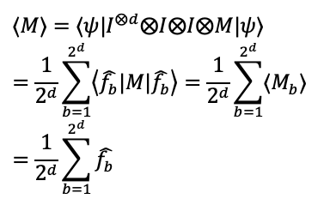
4. Measurement
Once the Learning via interference stage successfully encodes the probability of the test data belonging to either class 0 or 1 into the output test qubit, we make our prediction by simply measuring the prediction qubit (in the z-basis).
The expectation of this measurement is precisely the average prediction over the 2^{d} classifiers:

Slide 21
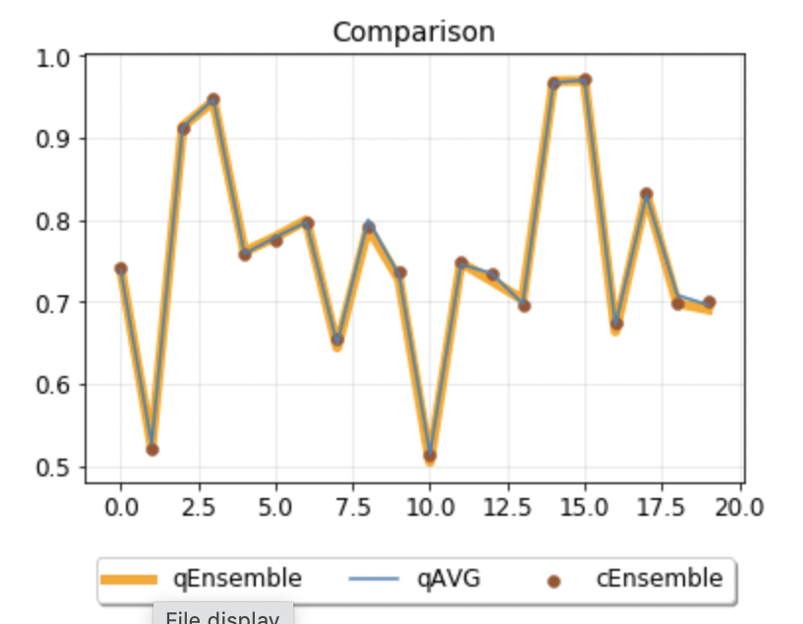

Slide 22
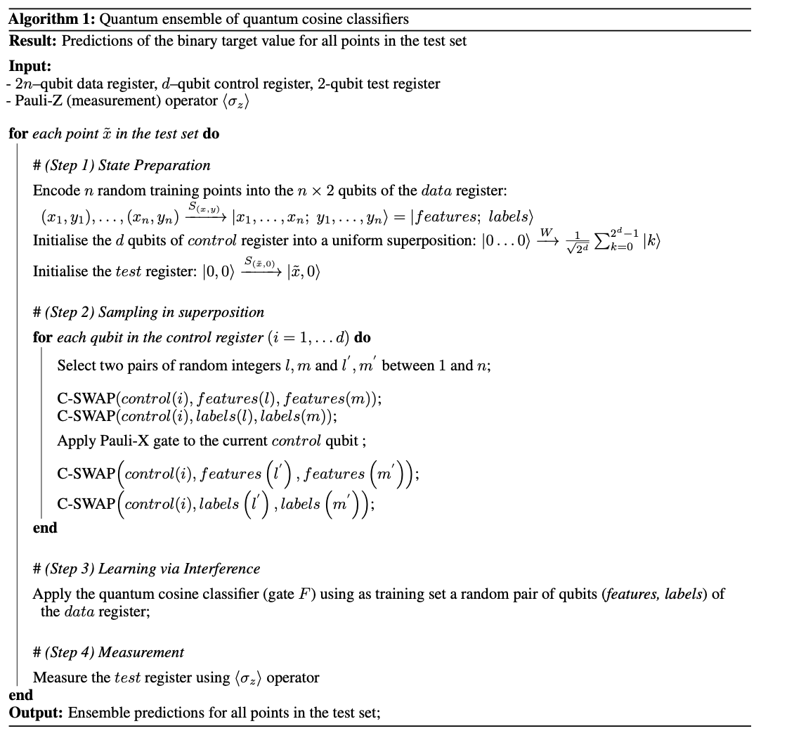
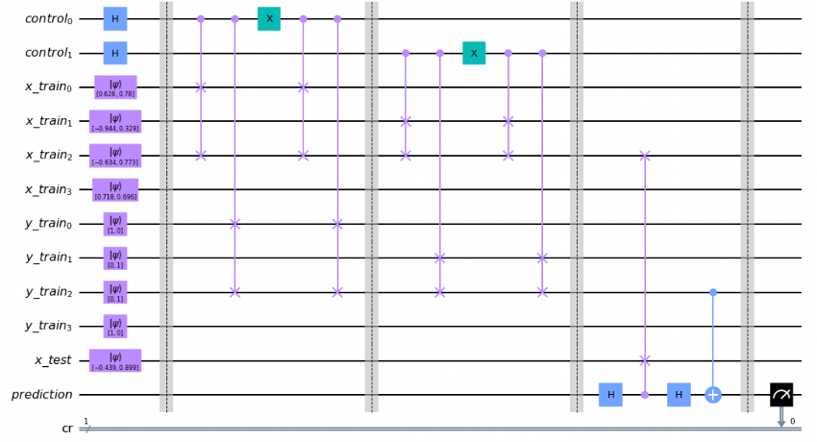
Recap of algorithm:

Slide 23
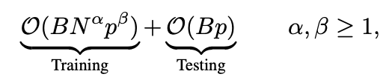
Complexity advantages of quantum ensemble
Classically, given B base models, N p-dimensional training data:
Quantum ensemble complexity depends on encoding scheme S(x,y) and unitaries U(i,j), which depends on data encoding. However, the advantage is generally 3-fold:
Generates 2^d trajectories/models in d steps.
Single execution of cosine classification is simultaneously propagated across all trajectories
Elimination of the averaging step

Slide 24
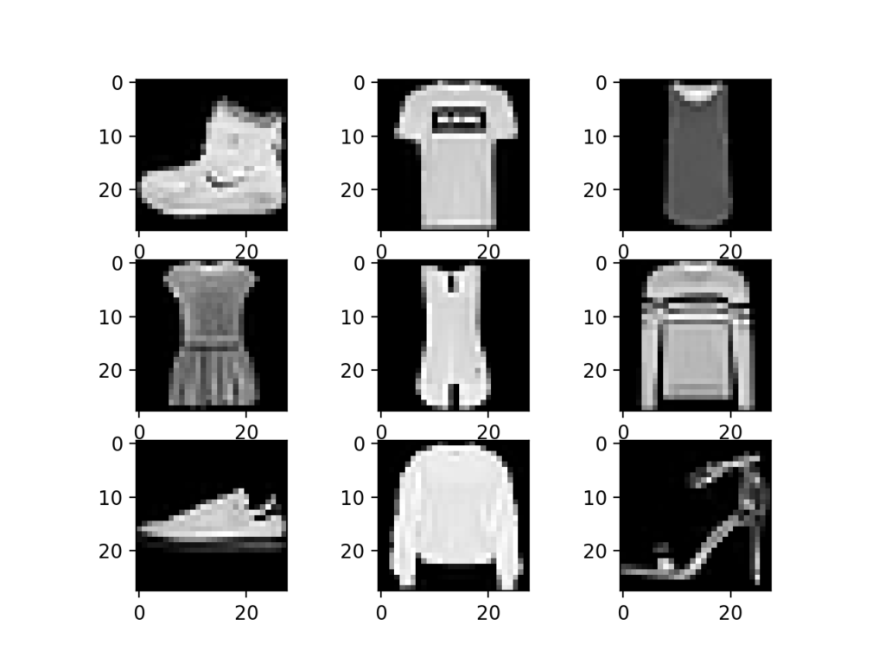

Experiments
Experimented on Digits MNIST and Fashion MNIST datasets

Slide 25
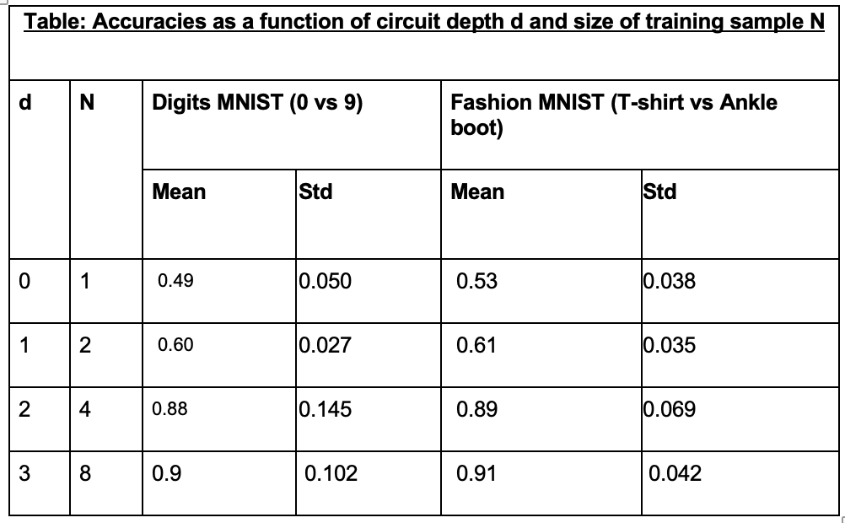

Slide 26
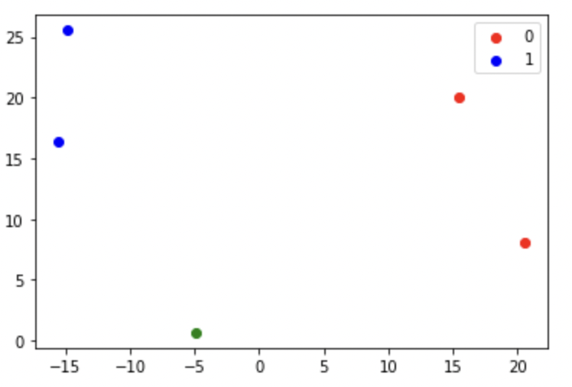
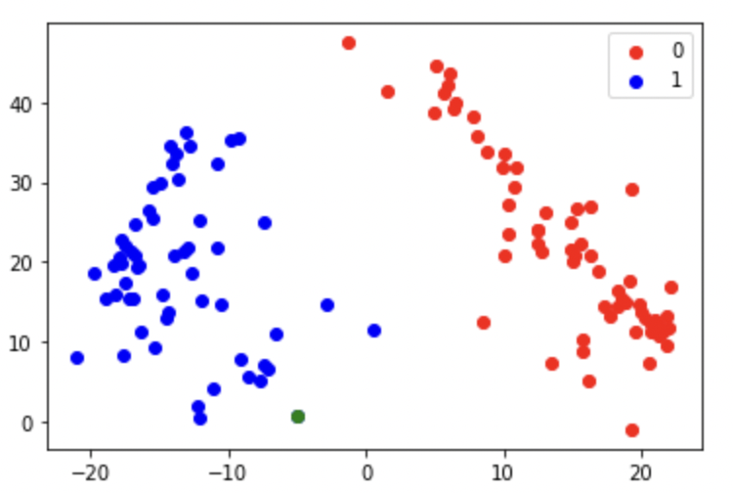
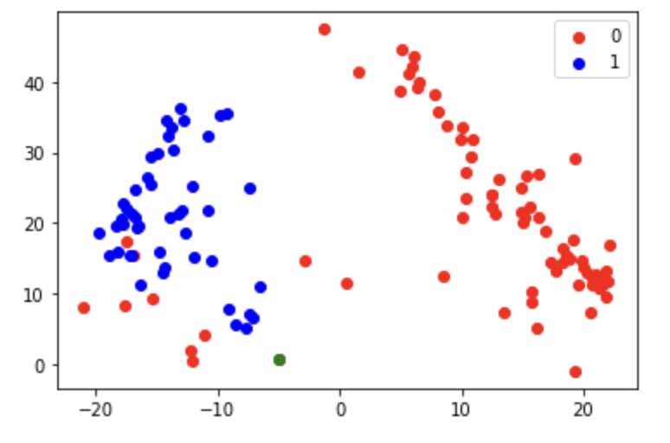
Example:
Correct labels of test set:
Predictions:
Training data:

Slide 27
Limitations of current model + extensions to the original paper:
Original paper:
Supports only 2-dimensional feature input, hence requires PCA preprocessing → Developed higher dimensional data encoding.
Cosine metric requires a little further preprocessing (i.e. shifting entire dataset up). → Developed L2 distance classifier.
Non-parametric circuit.
Predicts on test data one at a time → Can potentially parallelize predictions the same way sampling of training data was parallelized.

Slide 28
Extensions to original paper

Slide 29
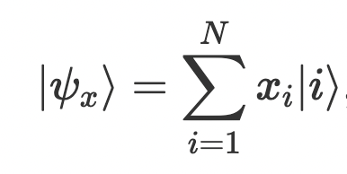
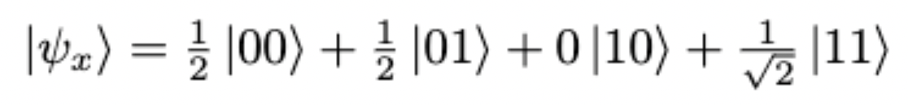
N-dimensional data encoding
Amplitude embedding
A normalized classical N-dimensional (N = 2^{n}) data point x = (x₁, …, x_{N}) can be represented by the amplitudes of a n-qubit quantum state |𝞧_{x}>
e.g. x = (½, ½, 0, 1/(2^{½}))
Notes:
Citation: https://pennylane.ai/qml/glossary/quantum_embedding.html

Slide 30
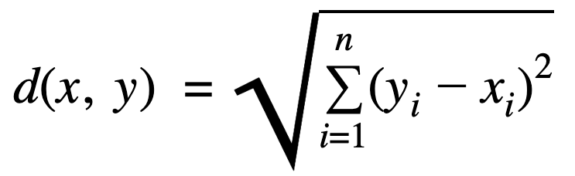
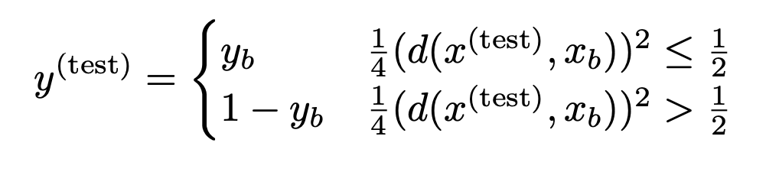
L2 Distance Classifier
Given two normalized N-dimensional vectors x and y
L2 / Euclidean distance between x and y is
0 ≤ d(x, y) ≤ 2 , so 0 ≤ (d(x, y))² ≤ 4
Given a training data point, (x_{b}, y_{b}) and a testing data point, x^{(test)} , we define the L2 Distance classifier as follows:

Slide 31
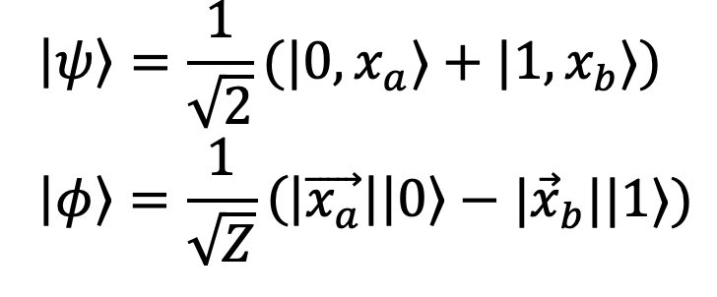
L2 Distance Classifier
Encode two 2^{n}-dimensional vectors x_{a} and x_{b} into two n-bit quantum states, |x_{a}> and |x_{b}>. The circuit outputs (d(x_{a},x_{b}))²/(2Z), where Z = |x_{a}|² + |x_{b}|²
Prepare an ancilla qubit and entangle it with |x_{a}> and |x_{b}>, such that the state of the whole system become:
Measure the ancilla qubit in the following basis:
It can be verified that the probability of getting the ancilla in the |𝛟> state is (d(x_{a},x_{b}))²/(2Z).
Notes:
https://arxiv.org/pdf/1909.04226.pdf

Slide 32
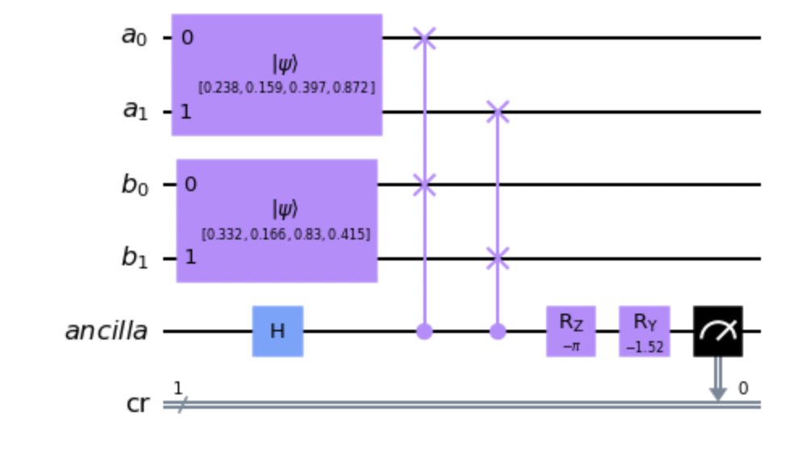
L2 Distance Classifier
How to prepare
Hadamard + CSWAP gate

Slide 33
L2 Distance Classifier
How to measure the ancilla in the following basis?
Currently, we assume that x_{a} and x_{b} are normalized. Thus |𝛟> = |->. Therefore, we only need to measure in the |+> and |-> basis.
If x_{a} and x_{b} are NOT normalized, in our quantum ensemble scenario where many pairs of samples are sharing the same ancilla, the projective measurement required for different pairs of samples may be different.
Notes:
So currently it’s unclear how to do the projective measurement for unnormalized xa and xb

Slide 34
L2 Distance Classifier
the probability of getting the ancilla in the |𝛟> state is (d(x_{a},x_{b}))²/(2Z)
We want the probability of getting the ancilla in the |𝛟> state (the new |0> state) and |𝛟^{T}> state (the new |1> state) to be related to y_{a}
Apply a CNOT gate to the ancilla, controlled by y_{a}
Assume that the closer the L2 distance between x_{a} and x_{b}, the more likely that y_{a} = y_{b} . Distance is negatively correlated with probability. Thus, we need to apply an X gate to the ancilla.
Notes:
Thus, the probability of getting the ancilla in the |𝛟> state is directly related the probability of y_{b} = 0.

Slide 35
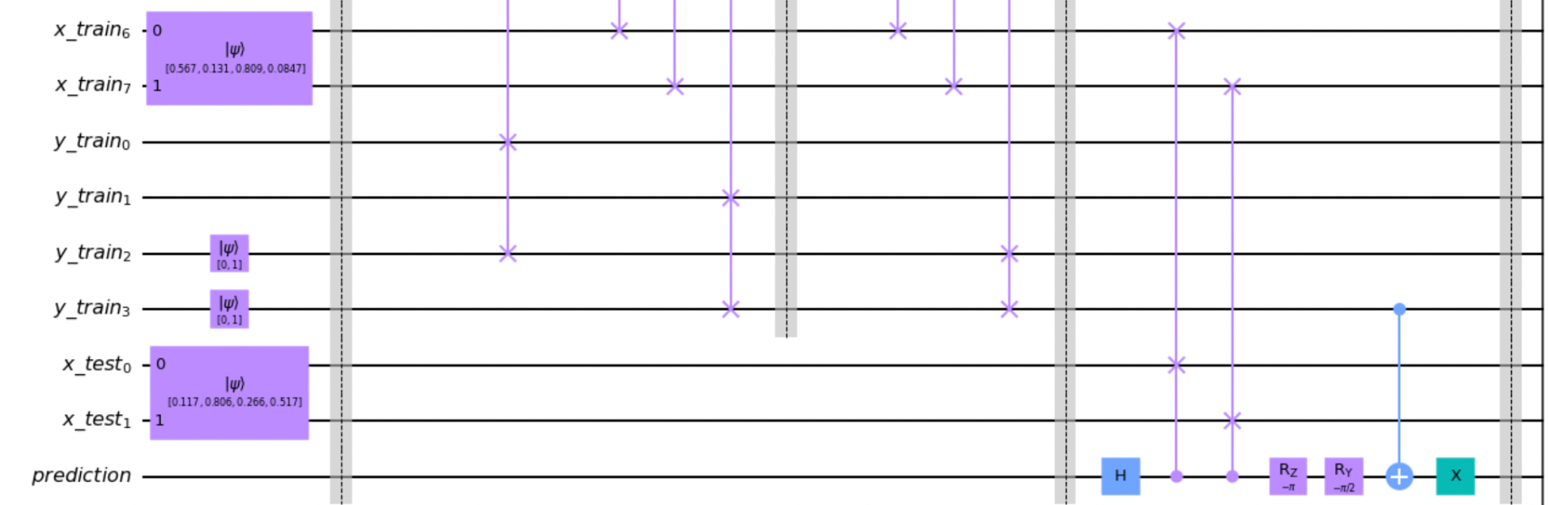
L2 Distance Classifier
Circuit
Ensemble Routine
Ancilla

Slide 36
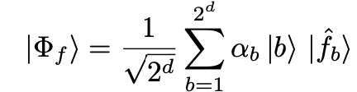
Quantum boosting methods (WIP)
Idea: Instead of sampling from each training data uniformly, classical boosting (e.g. AdaBoost) maintains a probability distribution over training data and updates the distribution to emphasize misclassified data. The next classifier to enter the ensemble is trained based on the updated distribution.
Adding classifiers one at a time to the ensemble defeats the point of parallelism. Instead, just have the circuit choose for itself which classifiers to emphasize. → Parametrize rotations on control registers and apply gradient descent against parameters with respect to loss function.
Notes:
Caveat: 2*d degrees of freedom generating 2^d weights. Weights are thus not independent.

Slide 37
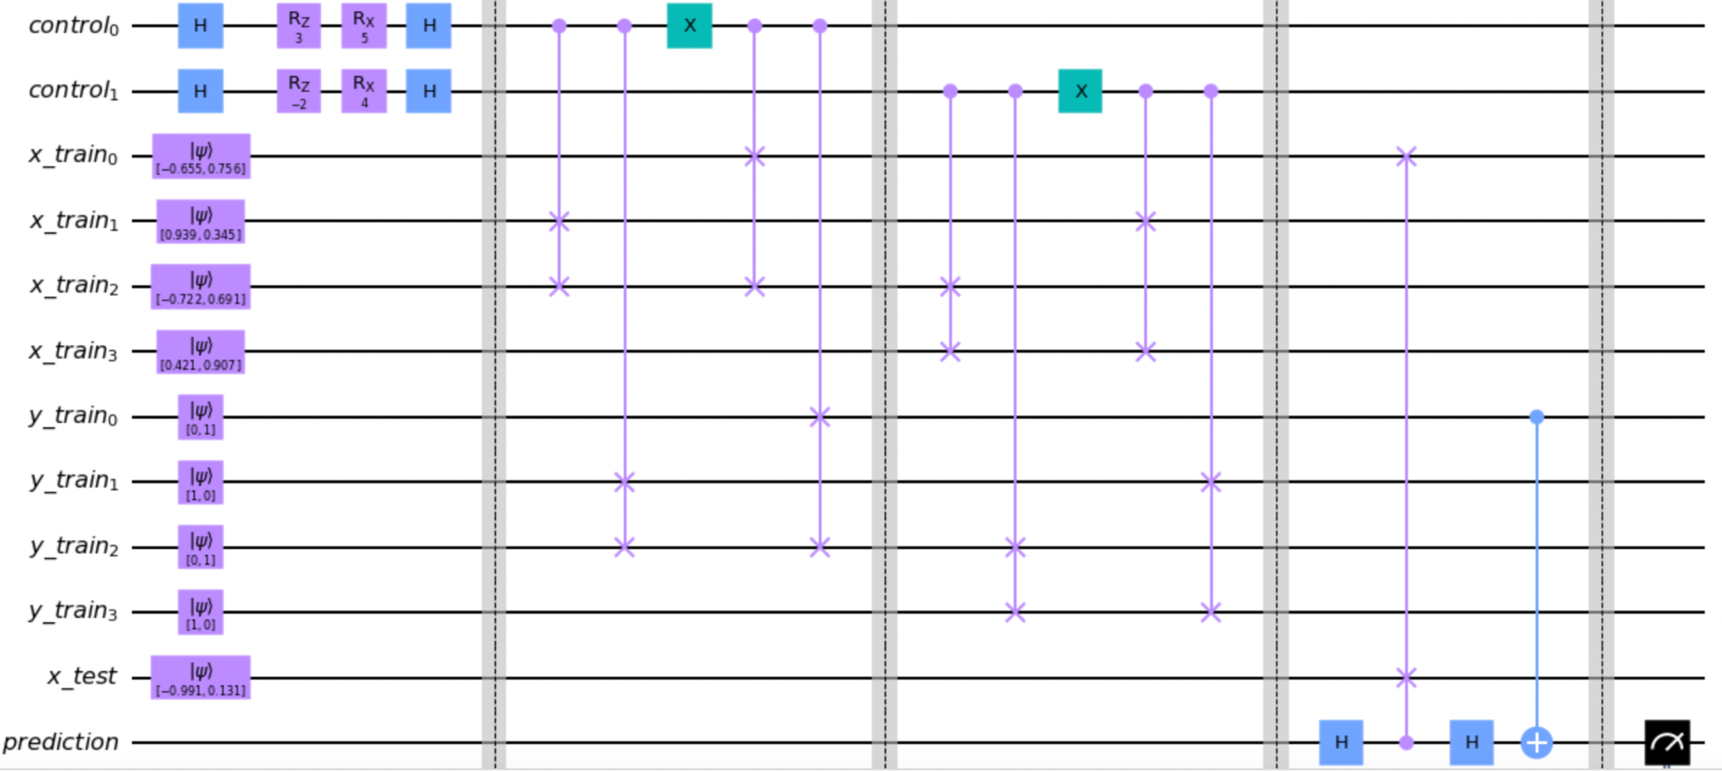
Recall: In general, we can also parameterize the U(i,j)’s to enable greater expressivity/flexible feature transformations for each subclassifier.

Slide 38
Acknowledgements
Macaluso, Antonio, et al. “Quantum Ensemble for Classification.” ArXiv.org, 18 Jan. 2022, https://arxiv.org/abs/2007.01028.
Lloyd, Seth, et al. “Quantum Algorithms for Supervised and Unsupervised Machine Learning.” ArXiv.org, 4 Nov. 2013, https://arxiv.org/abs/1307.0411.
Schuld, M., et al. “An Introduction to Quantum Machine Learning.” ArXiv.org, 10 Sept. 2014, https://arxiv.org/abs/1409.3097.
“Variational Classifier.” PennyLane, https://pennylane.ai/qml/demos/tutorial_variational_classifier.html.
Summary of data encoding methods: https://medium.datadriveninvestor.com/all-about-data-encoding-for-quantum-machine-learning-2a7344b1dfef
Custom gates and parameterization in Qiskit: https://qiskit.org/documentation/tutorials/circuits_advanced/01_advanced_circuits.html#Parameterized-circuits
Gradients in qiskit: https://qiskit.org/documentation/tutorials/operators/02_gradients_framework.html

Slide 39
Thank you!

Slide 40
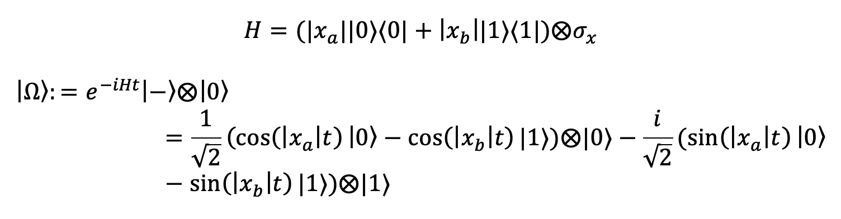
L2 Distance classifier: Details on generating psi and phi
Generating phi and estimating Z:
For small t, apply small-angle approximation and measure ancilla to obtain |phi> with probability:
Notes:
Optional slide

Slide 41
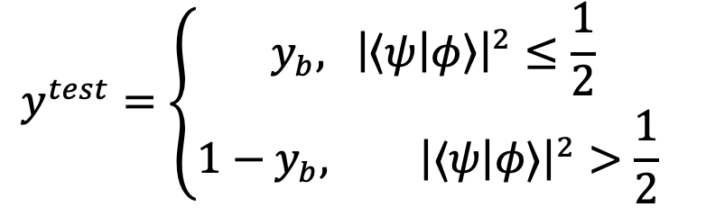
L2 distance classifier
Our classifier is thus:
This is in a form very similar to the cosine classifier, so we implement it in a similar way:
Notes:
Briefly explain what each component in the ancilla does. H+CSWAP generates psi, rotate+measurement simulates projection onto phi, which in this case is just | - >.

